Slide 2
Topics
Chapter 1 discusses the following main topics:
  Introduction
  Why Program?
  Computer Systems: Hardware and Software
  Programming Languages
  What Is a Program Made Of?
  The Programming Process
  Object-Oriented Programming

Slide 3
Introduction
This book teaches programming using Java
  Java is a powerful language that runs on practically every type of computer
  Java can be used to create large applications, small programs, mobile applications, and code that powers a website.
Before plunging right into learning Java, however, this chapter will:
  Review fundamentals of computer hardware and software
  Take a broad look at programming in general

Slide 4
Why Program?
Computers are tools that can be programmed to perform many functions, such as:
Computers are versatile because they can be programmed.
Computer Programmers implement programs that perform these functions.
  spreadsheets
  databases
  word processing
  games
  etc.

Slide 5
Why Program?
Aspects of a computer program that must be designed:
  The logical flow of the instructions
  The mathematical procedures
  The layout of the programming statements
  The appearance of the screens
  The way information is presented to the user
  The program’s “user friendliness”
  Manuals, help systems, and/or other forms of written documentation.

Slide 6
Why Program?
Programs must be analytically correct as well.
Programs rarely work the first time they are programmed.
Programmers must perform the following on a continual basis:
  analyze,
  experiment,
  correct, and
  redesign.
Programming languages have strict rules, known as syntax, that must be carefully followed.

Slide 7
Computer Systems: Hardware
Computer hardware components are the physical pieces of the computer.
The major hardware components of a computer are:
  The central processing unit (CPU)
  Main memory
  Secondary storage devices
  Input and Output devices

Slide 8
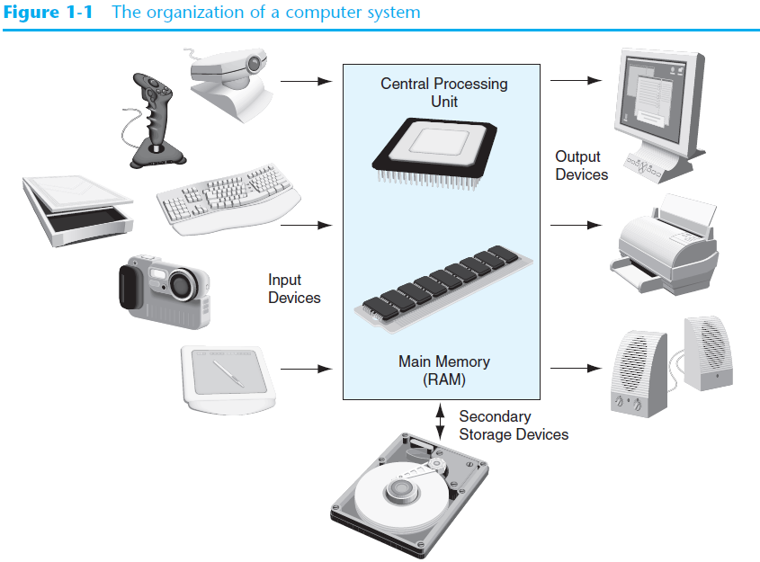
Computer Systems: Hardware

Slide 9
The CPU
At the heart of the computer is the central processing unit, or CPU
  The CPU’s job is to fetch instructions, follow instructions, and produce some resulting data
Internally, the CPU consists of two parts:
  Control Unit
    Coordinates all of the computer’s operations
  Arithmetic and Logic Unit (ALU)
    Performs mathematical operations

Slide 10
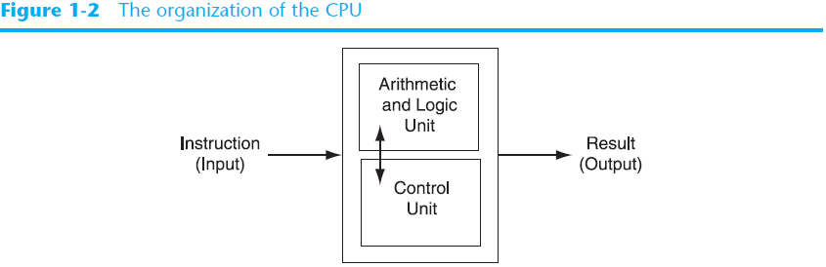
The CPU

Slide 11
The CPU
  A program is a sequence of instructions stored in the computer’s memory
  The CPU performs the fetch / decode / execute cycle in order to process program information.
    Fetch - the CPU’s control unit fetches, from main memory, the next instruction in the sequence of program instructions.
    Decode - the instruction is encoded in the form of a number. The control unit decodes the instruction and generates an electronic signal.
    Execute - the signal is routed to the appropriate component of the computer (such as the ALU, a disk drive, or some other device). The signal causes the component to perform an operation.

Slide 12
Main Memory
Commonly known as random-access memory (RAM)
RAM contains:
  currently running programs
  data used by those programs.
RAM is divided into units called bytes.
A byte consists of eight bits that may be either on or off.

Slide 13
Main Memory
A bit is either on or off:
  1 = on
  0 = off
The bits form a pattern that represents a character or a number.
Each byte in memory is assigned a unique number known as an address.
RAM is volatile, which means that when the computer is turned off, the contents of RAM are erased.

Slide 14
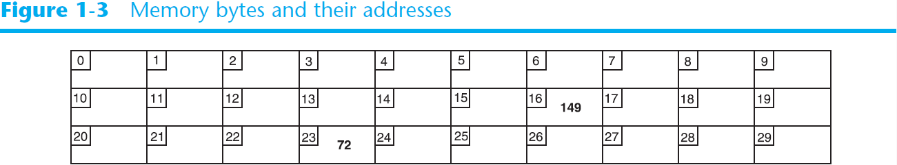
Main Memory
For example, a series of bytes with their addresses:
  The number 149 is stored in the byte at address 16
  The number 72 is stored in the byte at address 23

Slide 15

Secondary Storage
Secondary storage devices are capable of storing information for longer periods of time (non-volatile).
Common Secondary Storage devices:
  Disk drive
  Solid-state drive
  USB drive
  Optical devices
  CD / DVD

Slide 16
Input Devices
Input is any data the computer collects from the outside world.
That data comes from devices known as input devices.
Common input devices:
Disk drives, optical drives, and USB drives can also be considered input devices when data is read from those devices
  Keyboard
  Mouse
  Touchscreen
  Digital Camera

Slide 17
Output Devices
Output is any data the computer sends to the outside world.
That data is displayed on devices known as output devices.
Common output devices:
  Monitors
  Printers
Disk drives, USB drives, and CD/DVD recorders can also be considered output devices when data is sent to those devices to be saved

Slide 18
Computer Systems: Software
Software refers to the programs that run on a computer.
There are two classifications of software:
  Operating Systems
  Application Software

Slide 19
Operating Systems
An operating system is a set of programs that manages the computer’s hardware devices and controls their processes.
Most all modern operating systems are multitasking
  Capable of running multiple programs at once
  Through time sharing
    a multitasking system divides the allocation of hardware resources and the attention of the CPU among all the executing programs.

Slide 20
Operating Systems
Multitasking Operating Systems include:
  UNIX
  Linux
  Modern versions of:
    Windows
    Mac OS

Slide 21
Application Software
Application software refers to programs that make the computer useful to the user.
Application software provides a more specialized type of environment for the user to work in.
Common application software:
  Spreadsheets
  Word processors
  Accounting software
  Tax software
  Games

Slide 22
What is a Program?
A program is a set of instructions a computer follows in order to perform a task.
A programming language is a special language used to write computer programs.
A computer program is a set of instructions that enable the computer to solve a problem or perform a task.
Collectively, these instructions form an algorithm

Slide 23
What is a Program?
An algorithm is a set of well defined steps for performing a task or solving a problem.
The steps in an algorithm are performed sequentially.
A computer needs the algorithm to be written in machine language.
Machine language is written using binary numbers.
The binary numbering system (base 2) only has two digits (0 and 1).

Slide 24
What is a Program?
The binary numbers are encoded as a machine language.
Example of a machine language instruction:
    1011010000000101
Each CPU has its own machine language.
  If you wrote a program for computer A, and then wanted to run it on computer B, with a different CPU, you would have to rewrite the program in computer B’s machine language.

Slide 25
What is a Program?
Programming languages were invented to ease the task of programming
  Use words instead of numbers
A program can be written in a programming language and translated into machine language
  Programmers use software to perform this translation.

Slide 26
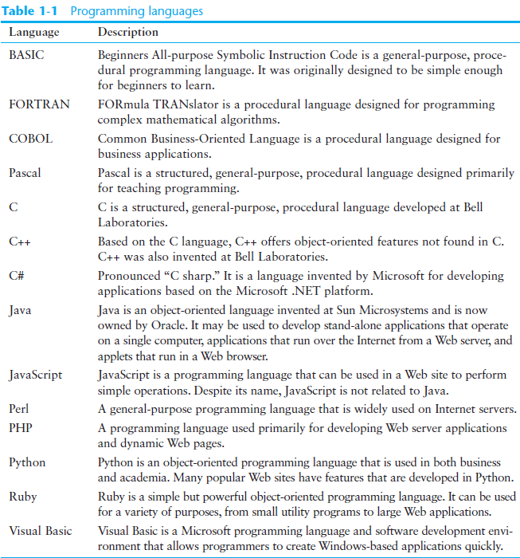

Slide 27
A History of Java
1991 - Green Team started by Sun Microsystems.
*7 Handheld controller for multiple entertainment systems.
There was a need for a programming language that would run on various devices.
Java (first named Oak) was developed for this purpose.

Slide 28
A History of Java
Java enabled web browser (HotJava) demonstrated at 1995 Sun World conference.
Java incorporated into Netscape shortly after.
Java is “cross platform”, meaning that it can run on various computer operating systems.

Slide 29
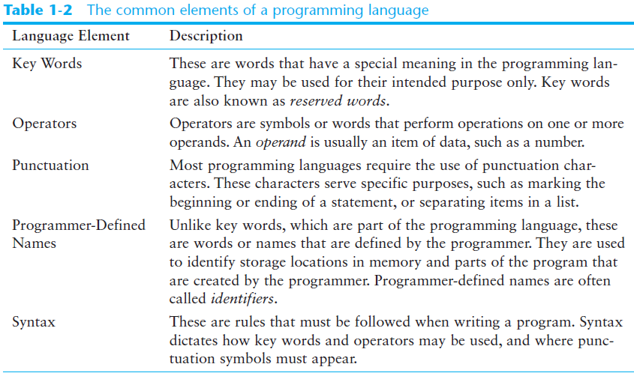
What is a Program Made Of?

Slide 30
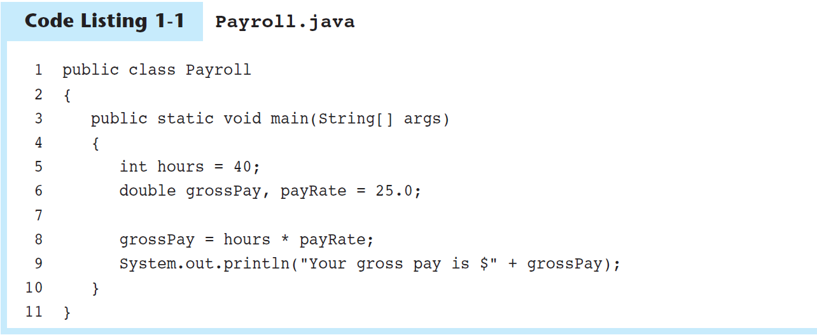
What is a Program Made Of?

Slide 31
What is a Program Made Of?
Key words in the sample program are:
Key words are lower case (Java is a case sensitive language).
Key words cannot be used as a programmer-defined identifier.
  public
  class
  static
  void

Slide 32
What is a Program Made Of?
Semi-colons are used to end Java statements
  However, not all lines of a Java program end a statement.
Part of learning Java is to learn where to properly use the punctuation.

Slide 33
What is a Program Made Of?
There are differences between lines and statements when discussing source code.
System.out.println(
message);
This is one Java statement written using two lines. Do you see the difference?
A statement is a complete Java instruction that causes the computer to perform an action.

Slide 34
What is a Program Made Of?
Data in a Java program is stored in memory.
Variable names represent a location in memory.
Variables are created by the programmer who assigns it a programmer-defined identifier.
    int hours = 40;
    The variable hours is created as an integer (more on this later) and assigned the value of 40.

Slide 35
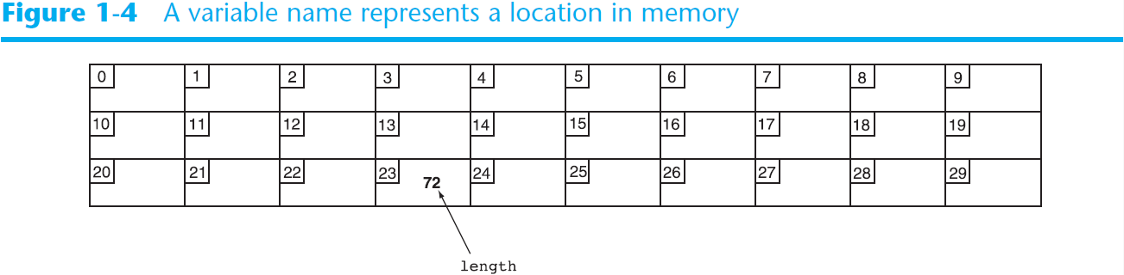
What is a Program Made Of?
Variables are simply a name given to represent a place in memory.

Slide 36
The Compiler and the Java Virtual Machine
A programmer writes Java programming statements for a program.
These statements are known as source code.
A text editor is used to edit and save a Java source code file.
Source code files have a .java file extension.
A compiler is a program that translates source code into an executable form.

Slide 37
The Compiler and the Java Virtual Machine
A compiler is run using a source code file as input.
Syntax errors that may be in the program will be discovered during compilation.
Syntax errors are mistakes that the programmer has made that violate the rules of the programming language.
The compiler creates another file that holds the translated instructions.

Slide 38
The Compiler and the Java Virtual Machine
Most compilers translate source code into executable files containing machine code.
The Java compiler translates a Java source file into a file that contains byte code instructions.
Byte code instructions are the machine language of the Java Virtual Machine (JVM) and cannot be directly executed directly by the CPU.

Slide 39
The Compiler and the Java Virtual Machine
Byte code files end with the .class file extension.
The JVM is a program that emulates a micro-processor.
The JVM executes instructions as they are read.
JVM is often called an interpreter.
Java is often referred to as an interpreted language.

Slide 40
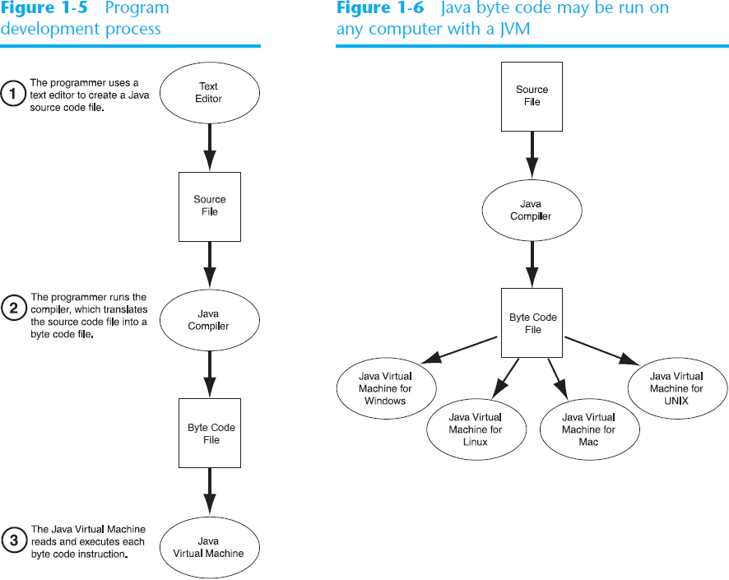

Slide 41
The Compiler and the Java Virtual Machine
Portable means that a program may be written on one type of computer and then run on a wide variety of computers, with little or no modification.
Java byte code runs on the JVM and not on any particular CPU; therefore, compiled Java programs are highly portable.
JVMs exist on many platforms:
Windows
Mac
Linux
Unix
BSD
Etc.

Slide 42
The Compiler and the Java Virtual Machine
With most programming languages, portability is achieved by compiling a program for each CPU it will run on.
Java provides an JVM for each platform so that programmers do not have to recompile for different platforms.

Slide 43
Java Software Editions
The software you use to write Java programs is called the Java Development Kit, or JDK.
There are different editions of the JDK:
  Java SE – Standard Edition
    Provides essential tools for developing applications and applets
  Java EE – Enterprise Edition
    Provides tools for creating large business applications that employ servers and provide services over the Web
  Java ME – Micro Edition
    Provides a small, optimized runtime environment for consumer products such as cell phones, pagers, and appliances
Available for download at http://java.oracle.com

Slide 44
Compiling a Java Program
The Java compiler is a command line utility.
The command to compile a program is:
    javac filename.java
javac is the Java compiler.
The .java file extension must be used.
  Example: To compile a java source code file named Payroll.java you would use the command:
    javac Payroll.java

Slide 45
Running a Java Program
To run the Java program, you use the java command in the following form:
java ClassFilename
ClassFilename is the name of the . class file that you wish to execute.
  However, you do not type the . class extension.
For example, to run the program that is stored in the Payroll.class file, you would enter the following command:
java Payroll
  This command runs the Java interpreter (the JVM) and executes the program.

Slide 46
Integrated Development Environments
In addition to the command prompt programs, there are also several Java integrated development environments (IDEs).
These environments consist of a text editor, compiler, debugger, and other utilities integrated into a package with a single set of menus.
A program is compiled and executed with a single click of a button, or by selecting a single item from a menu.

Slide 47
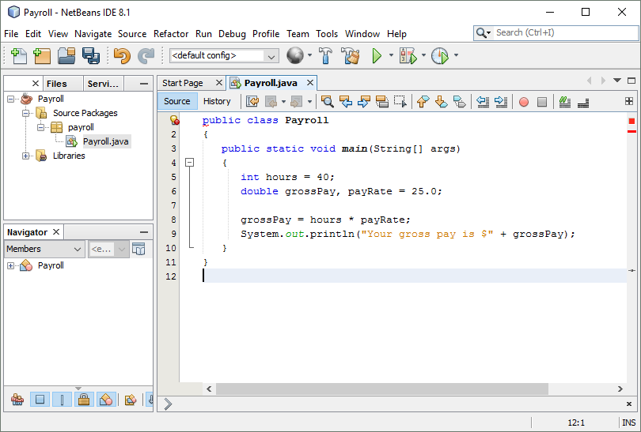
Integrated Development Environments

Slide 48
The Programming Process
1. Clearly define what the program is to do.
2. Visualize the program running on the computer.
3. Use design tools to create a model of the program.
4. Check the model for logical errors.
5. Enter the code and compile it.
6. Correct any errors found during compilation.
  Repeat Steps 5 and 6 as many times as necessary.
7. Run the program with test data for input.
8. Correct any runtime errors found while running the program.
  Repeat Steps 5 through 8 as many times as necessary.
9. Validate the results of the program.

Slide 49
Object-Oriented Programming
Older programming languages were procedural.
A procedure is a set of programming language statements that, together, perform a specific task.
Procedures typically operate on data items that are separate from the procedures.
In a procedural program, the data items are commonly passed from one procedure to another

Slide 50
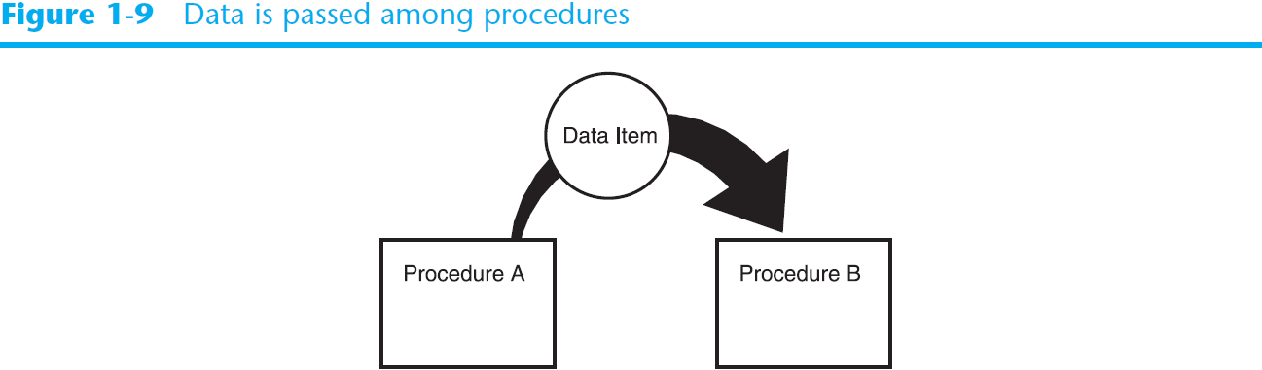
Object-Oriented Programming

Slide 51
Object-Oriented Programming
In procedural programming, procedures are developed to operate on the program’s data.
Data in the program tends to be global to the entire program.
Data formats might change and thus, the procedures that operate on that data must change.

Slide 52
Object-Oriented Programming
Object-oriented programming is centered on creating objects rather than procedures.
Objects are a melding of data and procedures that manipulate that data.
Data in an object are known as attributes.
Procedures in an object are known as methods.

Slide 53
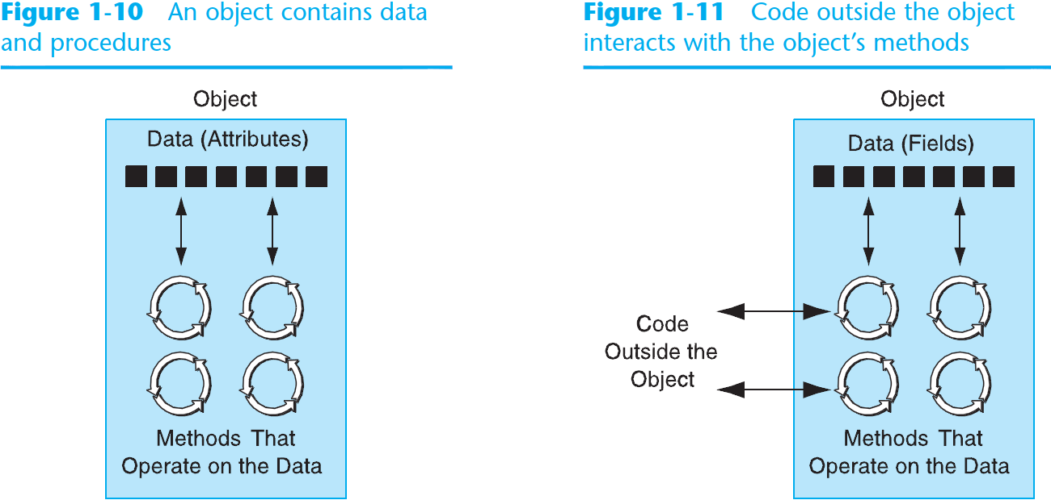
Object-Oriented Programming

Slide 54
Object-Oriented Programming
Data hiding is important for several reasons.
  It protects of attributes from accidental corruption by outside objects.
  It hides the details of how an object works, so the programmer can concentrate on using it.
  It allows the maintainer of the object to have the ability to modify the internal functioning of the object without “breaking” someone else’s code.

Slide 55
Object-Oriented Programming
Object-Oriented Programming (OOP) has encouraged component reusability.
A component is a software object contains data and methods that represents a specific concept or service.
Components typically are not stand-alone programs.
Components can be used by programs that need the component’s service.
Reuse of code promotes the rapid development of larger software projects.

Slide 56
An Everyday Example of an Object
Data attributes: define the state of an object
  Example: clock object would have second, minute, and hour data attributes
Public methods: allow external code to manipulate the object
  Example: set_time, set_alarm_time
Private methods: used for object’s inner workings

Slide 57
Classes and Objects
Components are objects.
The programmer determines the attributes and methods needed, and then creates a class.
A class is a collection of programming statements that define the required object
A class as a “blueprint” that objects may be created from.
An object is the realization (instantiation) of a class in memory

Slide 58
Classes and Objects
Classes can be used to instantiate as many objects as are needed.
Each object that is created from a class is called an instance of the class.
A program is simply a collection of objects that interact with each other to accomplish a goal.

Slide 59
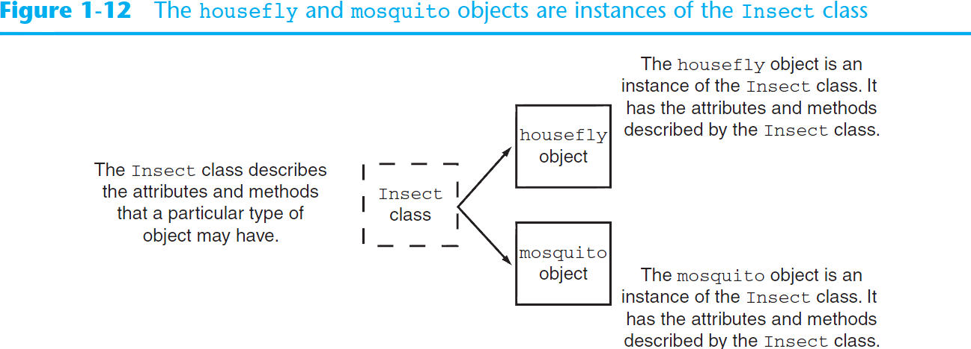
Classes and Objects

Slide 60
Inheritance
Inheritance is the ability of one class to extend the capabilities of another.
Consider the class Car.
A Car is a specialized form of the Vehicle class.
So, is said that the Vehicle class is the base or parent class of the Car class.
The Car class is the derived or child class of the Vehicle class.

Slide 61
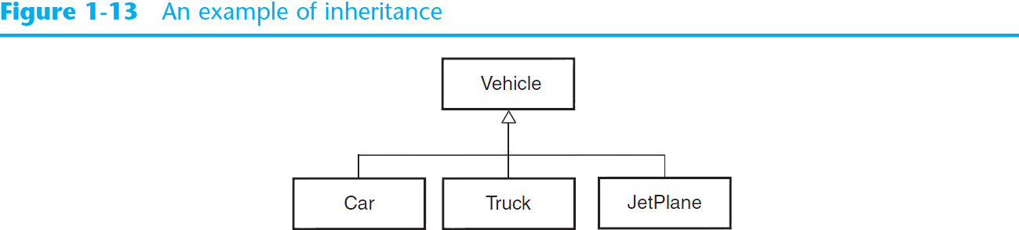
Inheritance

Slide 62
Software Engineering
Encompasses the whole process of crafting computer software.
Software engineers perform several tasks in the development of complex software projects.
  Designing
  Writing
  Testing
  Debugging
  Documenting
  Modifying
  Maintaining

Slide 63
Software Engineering
Software engineers also use special software designed for testing programs.
Most commercial software applications are large and complex.
Usually a team of programmers, not a single individual, develops them.
Program requirements are thoroughly analyzed and divided into subtasks that are handled by
  Individual teams
  Individuals within a team

